Slide 1
LETTER WRITING
Sumaiya Sharmin
Lecturer
Department of English
Daffodil International University

Slide 2
Discussion Outline
Letter Writing (GW 1)
Types of Letter Writing
Different Samples of IELTS letter

Slide 3
Letter Writing (GW1)
A letter is a written message conveyed from one person to another through a medium.
In Task 1 of the IELTS General Writing section, you must write a letter about a given situation.
Also, every General IELTS Writing Task 1 includes three bulleted points which you need to mention in your letter.
Make sure you include these three points or else you will not get high marks, no matter how well you write.

Slide 4
Continued…
Write at least 150 words.
You do NOT need to write any address.
In this task, you should spend about 20 minutes.

Slide 5
Types of Letter
Different kinds of letters vary depending on the level of familiarity (known, unknown, close) with the person being written to.
Therefore, each kind of letter requires a different style of writing-
a specific beginning and ending salutation/greeting
formal or informal expressions
varying types of grammatical forms

Slide 6
Continued…
Depending on that letters are basically categorized into three types-
Formal Letter
Informal Letter
Semi-formal Letter

Slide 7
Formal Letter
A formal letter-
follows a certain formality and pattern
are precise and kept strictly professional in nature
is usually written to an unknown person
Example:
Business letter
Official letter
Letter of enquiry
Order letter
Promotion letter
Sales letter and so on

Slide 8
Sample Formal Letter
In a formal letter-
The tone should be official, business-like and serious
The beginning salutation/greeting should be “Dear Sir / Madam”
Must maintain the absence of contractions
Must aware of the use of formal expressions (e.g. I am writing in connection with...)
The closing salutation should be "Yours faithfully" instead of the more informal "Yours sincerely" or "Best regards"

Slide 9
Given Situation for Formal Letter Writing
Topic: Complaining to a Hotel
You recently stayed in a hotel in a large city. The weather was very unusual for the time of year and the heating / cooling system in the hotel was quite inadequate. Now, write a letter to the manager of the hotel.
In your letter:
Give details of what went wrong
Explain what you had to do to overcome the problem at the time
Say what action you would like the manager to take

Slide 10
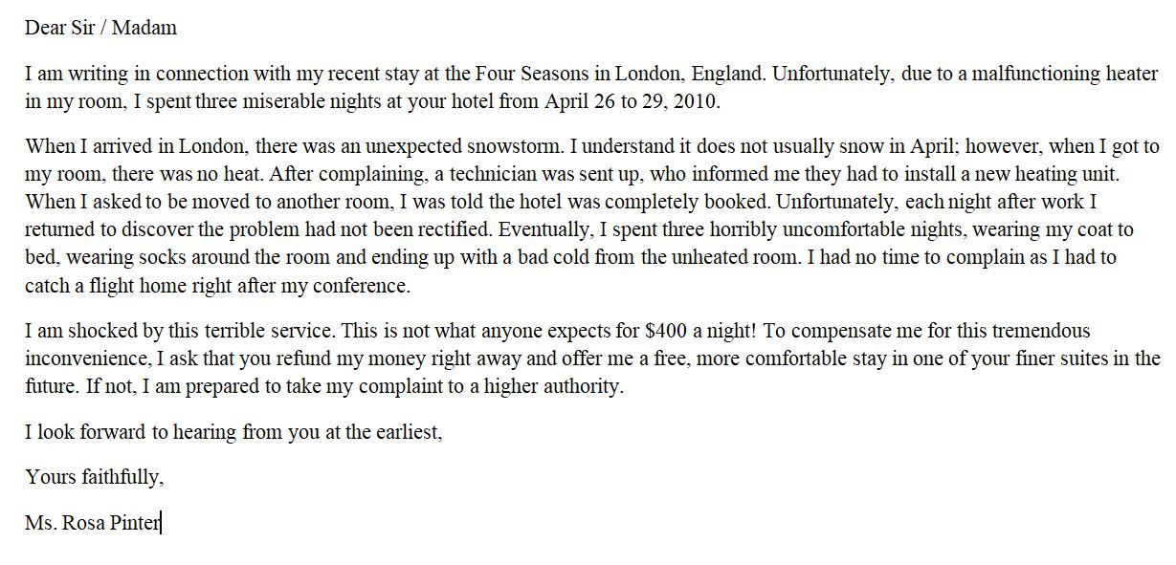
Begin Your Letter as Follows

Slide 11
Informal Letter
Informal letters are also called personal letters.
No need to maintain formality
Contain personal information
Example:
This kind of letter is usually written to a person(s) who are very well-known or close to the person who writes the letter, such as friends, family members and so on.

Slide 12
Sample Informal Letter
In an informal letter-
The tone should be warm, easy-going and conversational
The beginning salutation/greeting can be the first names (e.g. Ajay, Sunita, Carol)
Can maintain the presence of contractions (e.g. I've, don't, can't)
Use of informal expressions (e.g. "Thanks", instead of "Thank you")
The closing salutation should be warm (e.g. "Warm wishes", instead of the more formal "Yours sincerely" or "Yours faithfully")

Slide 13
Given Situation for Informal Letter Writing
Topic: Thanking & Inviting a Friend
Last month you had a holiday overseas where you stayed with some friends. They have just sent you some photos of your holiday. Write a letter to your friend.
In your letter:
Thank them for the photos and for the holiday
Explain why you didn't write earlier
Invite them to come and stay with you

Slide 14
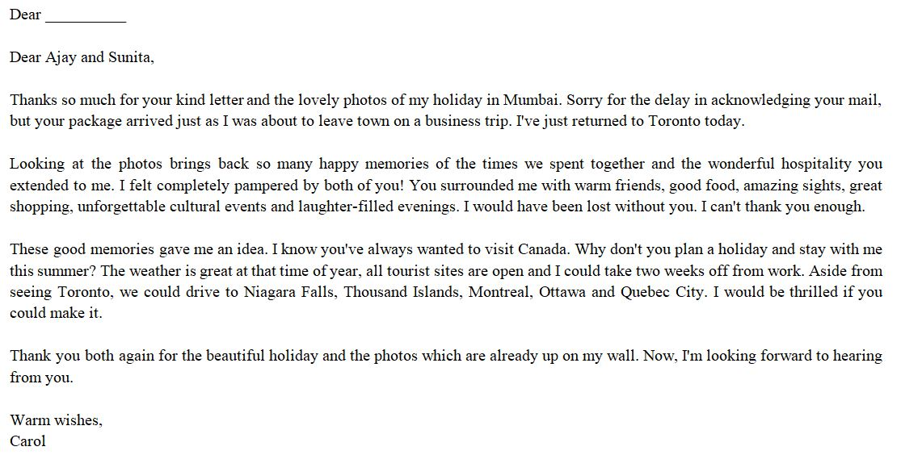
Begin Your Letter as Follows

Slide 15
Semi-formal Letter
A semi formal is a blend of both formal and informal.
A semi-formal letter follows the same pattern as the formal letter.
Though it is more related to the informal letter than to the formal letter where either the subject matter is formal but is addressed to near ones or subject matter is partially formal.
Semi-formal letters are letters we write to people who are not totally strange to us but are not close enough to us to deserve personal letters.
Example:
To our teachers, family doctor, priest, landlords, etc.

Slide 16
Sample Semi-formal Letter
In a semi-formal letter-
The tone should be a mix of formality and warmth
The beginning salutation/greeting can be the last names (e.g. Dear Mr. Aziz)
Should maintain the absence of contractions (e.g. I've, don't, can't)
Use of formal expressions (e.g. I would appreciate it if...)
The closing salutation should be warm yet formal (e.g. Yours sincerely)

Slide 17
Given Situation for Semi-formal Letter Writing
Topic: Complaining to a Landlord
You have been living in a rental apartment for the past year. Recently a new neighbor moved in and has been making a lot of noise, which disturbs you. Write a letter to the landlord.
In your letter:
explain the situation
describe why it bothers you
suggest a solution

Slide 18
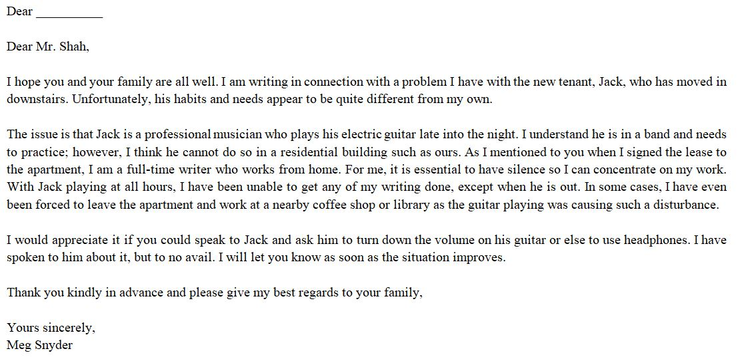
Begin Your Letter as Follows

Slide 19
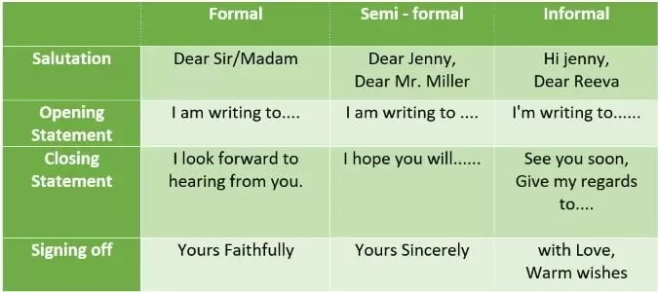
Difference Between Semi/In/Formal Letter

Slide 20
Any Question?

Slide 21
Thank You

